Slide 1
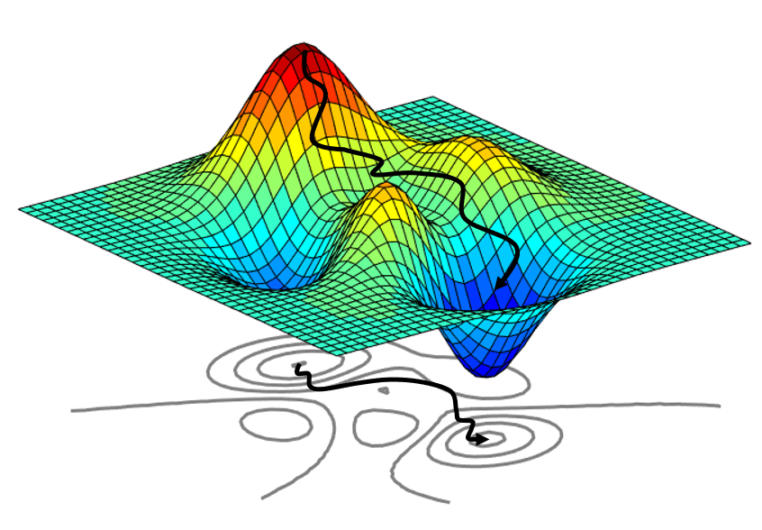




STMO Project defense
Pathfındr ghent
Dilara ağacık – Robbe fonteyn – Kaan turker
Lecturer : Prof. Dr Paul Van Liedekerke
Selected Topics in Mathematical Optimization
Notes:
Today we are going to present our STMO project called Pathfindr Ghent.

Slide 2
OBJECTIVE
Notes:
First let’s start with our objectives

Slide 3
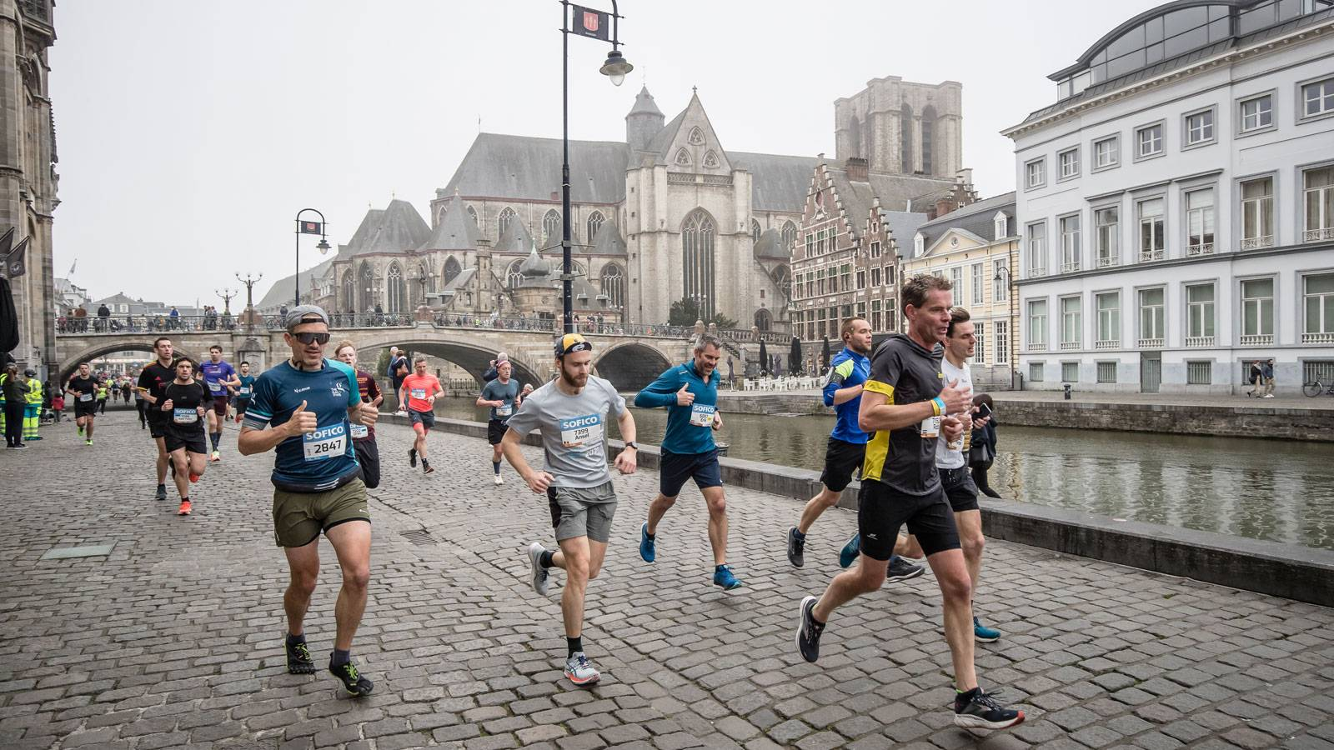

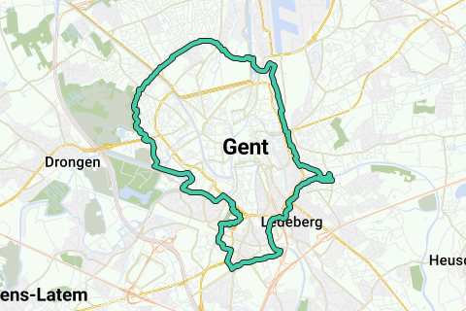
Runnıng route problem
Notes:
We would like to join a marathon in the upcoming months, and we need a running route with a desired distance. Additionally, we don't want it to be boring—we want to run through interesting locations. This is why we came up with this problem.

Slide 4
Problem defınıtıon
Notes:
Moving on to the problem definition now of our project

Slide 5
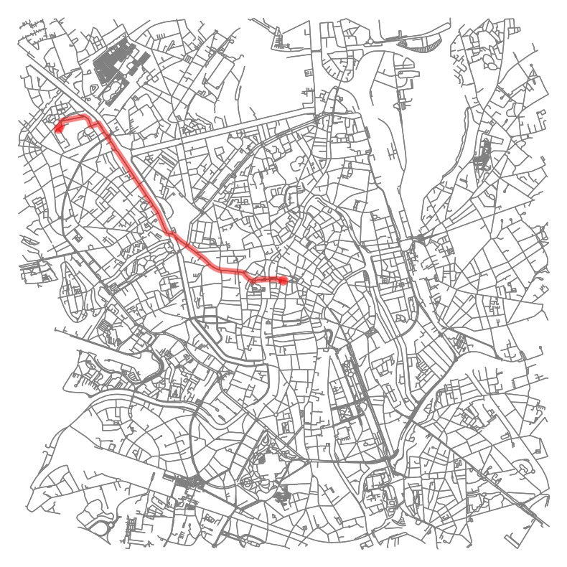
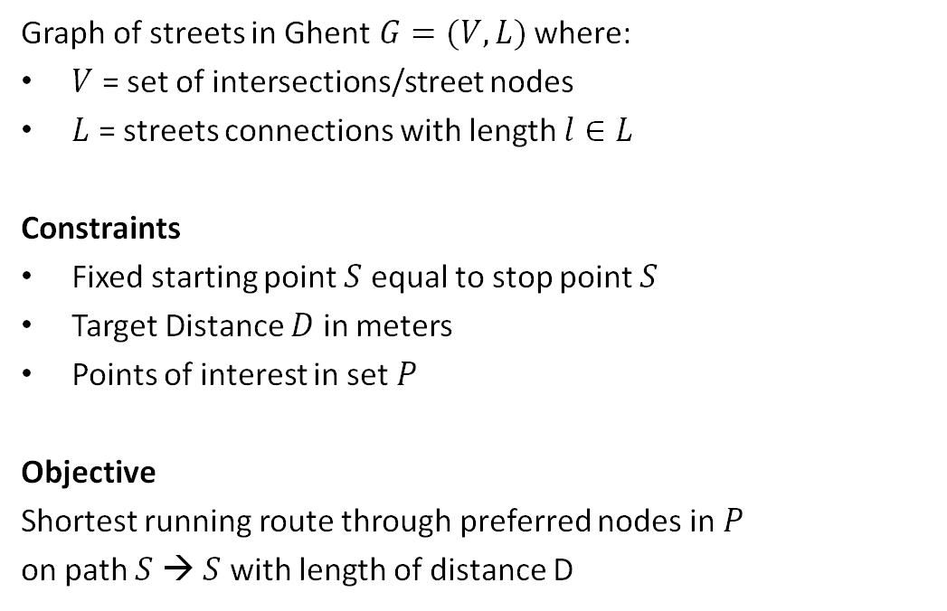
Pathfındr ghent: A graph problem
Graph of streets in Ghent$G=(V,L)$ where:
$V$ = set of intersections/street nodes
$L$ = streets connections with length $l∈L$
Constraints
Fixed starting point $S$ equal to stop point $S$
Target Distance $D$ in meters
Points of interest in set $P$
Objective
Shortest running route through preferred nodes in $P$ on path $S$ → $S$ with length of distance D
Notes:
We will use a graph of the city of Ghent, with the nodes representing the intersections of streets and the edges the streets connecting the different nodes with length l.
The problem has a couple of constraints, a fixed starting point S which also serves as our ending point S. A target distance D we would like the total path to be and a set P with points of interest we want to visit along the way. Our objective then becomes the shortest running route through preferred nodes in P on path of S to S around a length of D.

Slide 6
Approach 1 :
Brute force algorithm

Slide 7
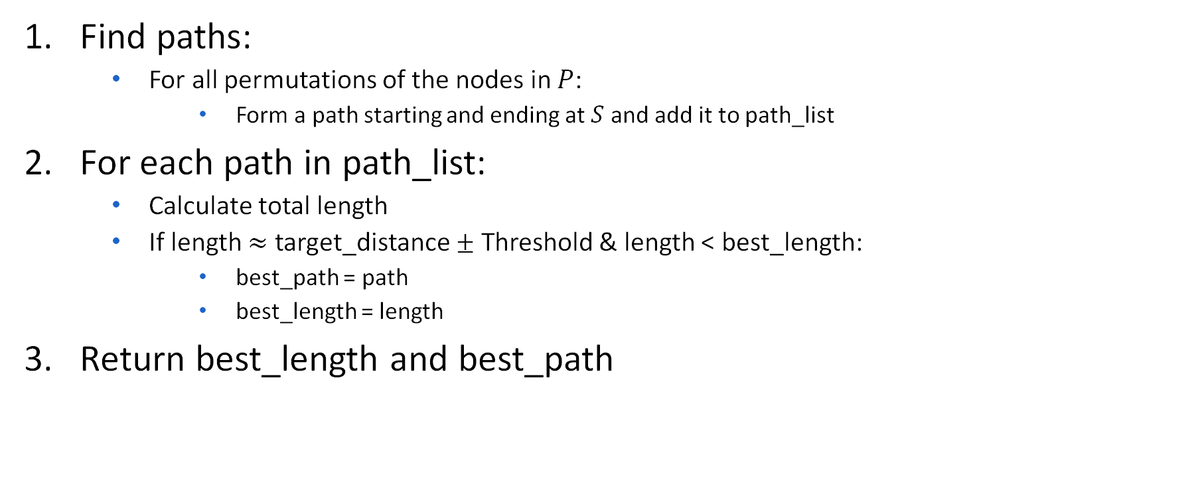
Pseudocode for brute force algorıthm
Find paths:
For all permutations of the nodes in $P$:
Form a path starting and ending at $S$ and add it to path_list
For each path in path_list:
Calculate total length
If length $≈$ target_distance $±$ Threshold & length < best_length:
best_path = path
best_length = length
Return best_length and best_path

Slide 8
Approach 2: Genetic algortihm
Notes:
Next is a heuristic approach, a genetic algorithm implentation

Slide 9
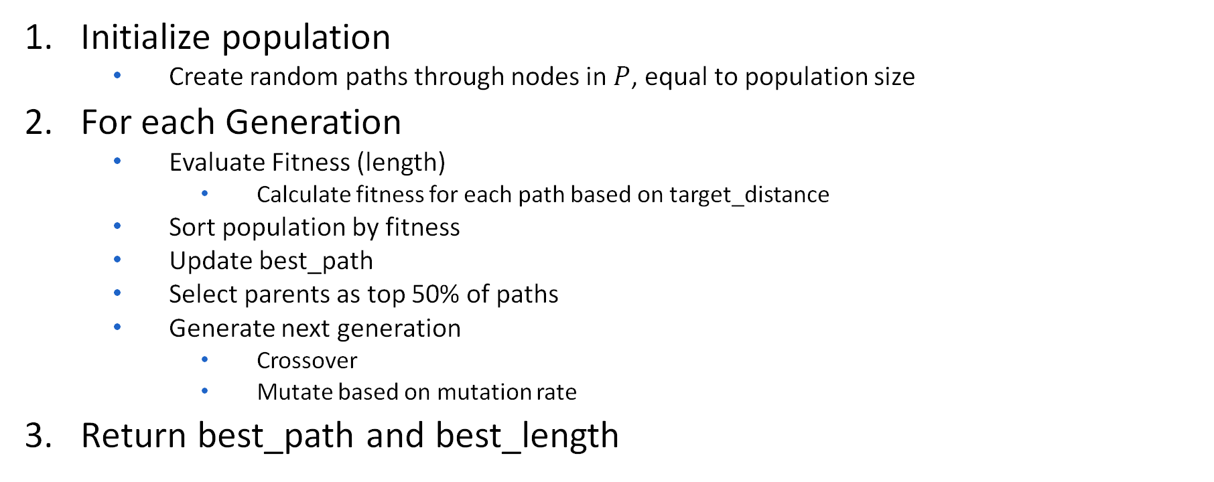
PSEUDOCODE FOR GENETIC ALGORITHM
Initialize population
Create random paths through nodes in $P$, equal to population size
For each Generation
Evaluate Fitness (length)
Calculate fitness for each path based on target_distance
Sort population by fitness
Update best_path
Select parents as top 50% of paths
Generate next generation
Crossover
Mutate based on mutation rate
Return best_path and best_length
Notes:
The pseudocode looks like this

Slide 10
Approach 3: sımulated annealing
Notes:
Our third approach is simulated annealing

Slide 11
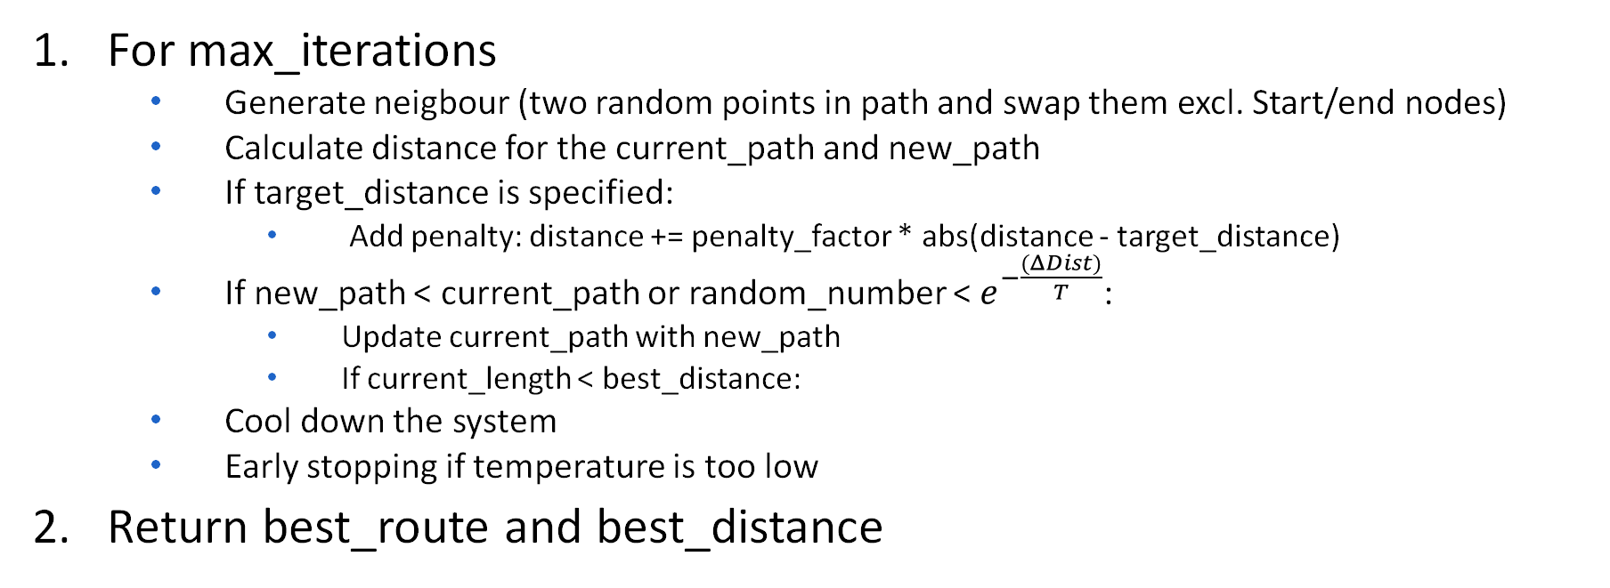
PSEUDOCODE FOR SIMULATED ANNEALING
For max_iterations
Generate neigbour (two random points in path and swap them excl. Start/end nodes)
Calculate distance for the current_path and new_path
If target_distance is specified:
Add penalty: distance += penalty_factor * abs(distance - target_distance)
If new_path < current_path or random_number < $e^{−\frac{(ΔDist)}{T}}$:
Update current_path with new_path
If current_length < best_distance:
Cool down the system
Early stopping if temperature is too low
Return best_route and best_distance
Notes:
It starts with random points and swap them and later it calculates the distance, if target distance specified adds penalty to make it close to desired distance later it looks at the new path if its shorter than old one it accepts it and if its not it will accept with a probability and later system gradually cools down. Ans system stops when its cool enough.

Slide 12
Results and comparıson

Slide 13
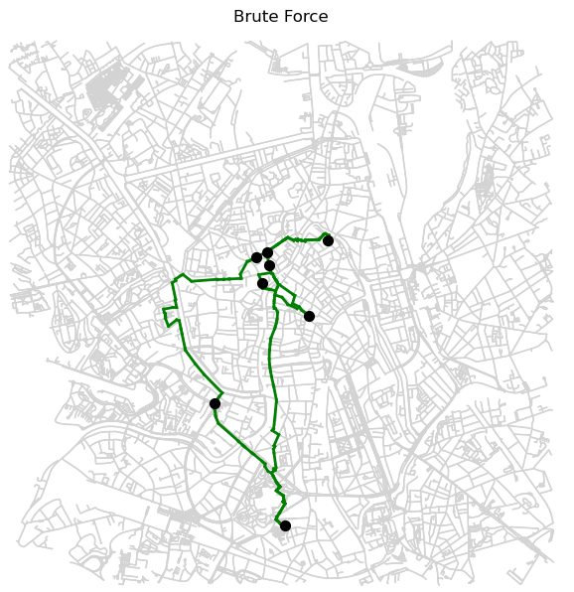
The Brute Force algorithm took the most time (~1h) compared to the Genetic Algorithm and Simulated Annealing. In the end it found a valid path with length of 9900.33 meters with a set threshold of 100 meters, as it evaluates all possible route permutations to guarantee the optimal solution. However, its high computational cost makes it impractical for larger datasets.
Path Length: 9900.33 meters
CPU times: total: 58min 34s

Slide 14
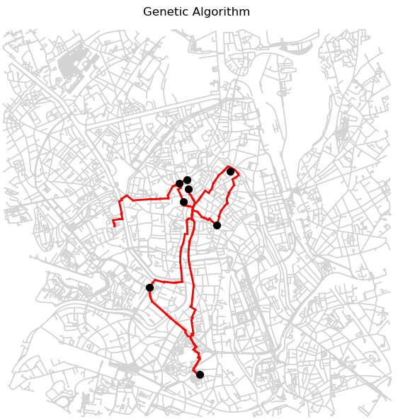
The Genetic Algorithm, with a runtime of around 2 min and a path length of 9998.59 meters, demonstrated scalability and robustness, making it ideal for larger datasets. While it didn’t guarantee a global optimum and occasionally reused streets, it closely matched the target distance and offers a practical solution for computationally constrained scenarios.
Path Length: 9998.59 meters
CPU times: total: 2min 20s

Slide 15
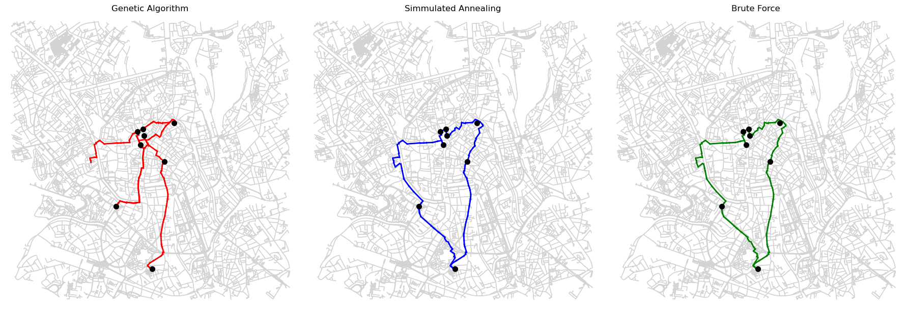
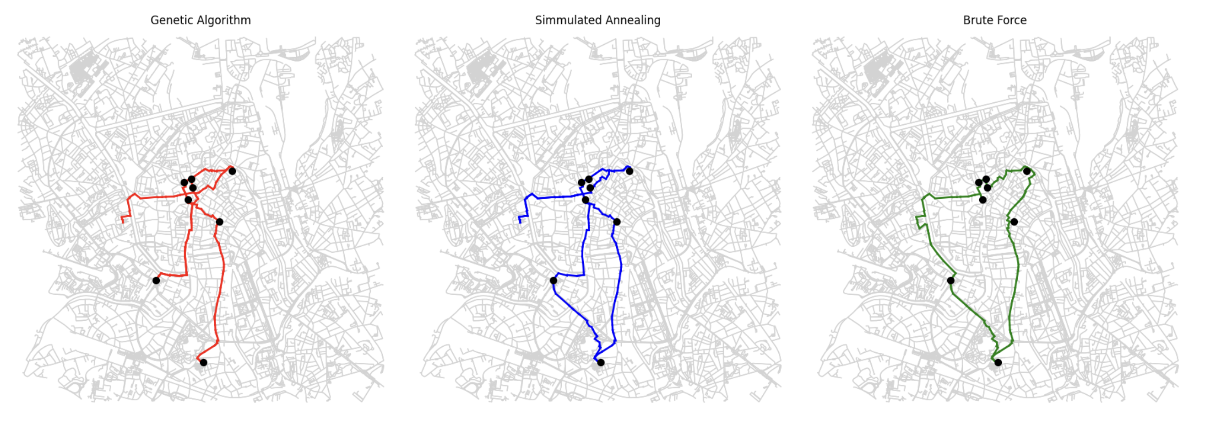
Target distance specified
Simulated Annealing provided a near-optimal solution with a path length of 8444.79 meters if we loosen the distance constraint and a computational time of around 2 min.
Taking into account the target distance constraint, it found a path through all the points of interest that is about 10211.61 meters long, in about 2 minutes.
While it doesn’t guarantee a global optimum, it effectively balances accuracy and runtime by exploring solutions probabilistically and avoiding local optima.
Path Length: 8444.79 meters
CPU times: total: 1min 42s
Path Length: 10211.61 meters
CPU times: total: 1min 58s
Notes:
In simulated annealing result we wanted to also see shortest path without any target distance specified as you can see its around 8 km for target distance specified its around 10 km.

Slide 16
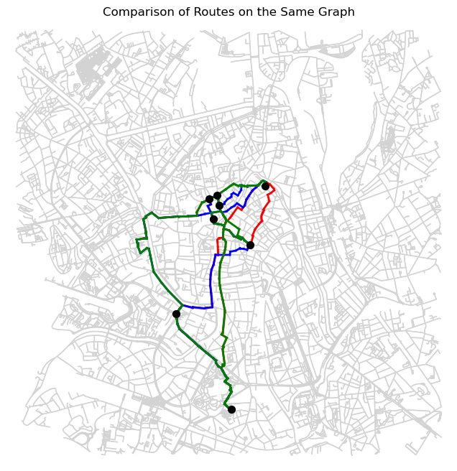
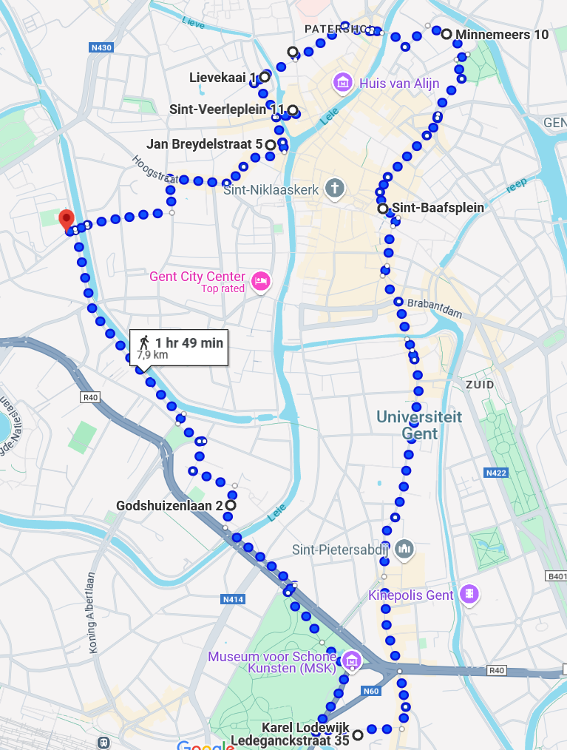
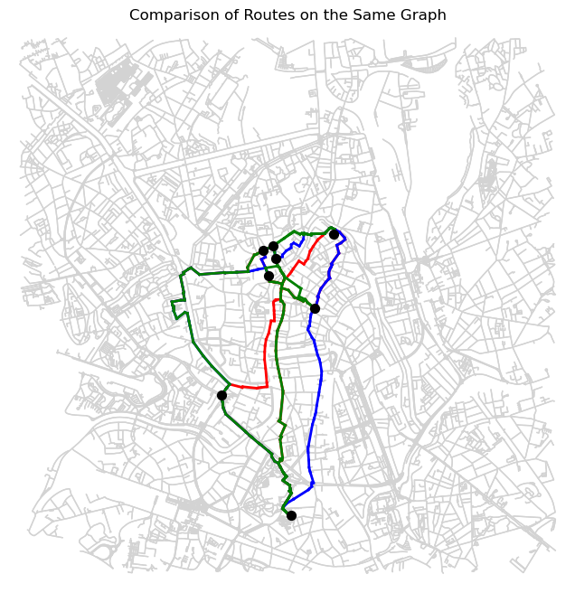
Conclusion:
Small differences
Mainly when POIs are close together
Parameter Tuning?

